Slide 1
Success Plan Overview
Who | All students in grades 7 – 12.
What | A journey of self-assessment, career research, and post-secondary options.
Why | To ensure that all CBSD students have the knowledge and skills they need to thrive in the rapidly changing workplace. *Proficient completion of the Success Plan is a CBSD graduation requirement.
How | Using Naviance, students will take various surveys to identify their unique skills and aptitudes and discover what “sparks” their interests and use specific research tools to investigate which career pathways are best suited to their skills and interests. Each year of the Success Plan, students will reflect upon their grade-level activities and use their newly-gained insights to make decisions about program planning, extra-curricular participation, and community engagement.
When | There are 4 – 5 tasks each year divided up over 4 marking periods. Tasks will be completed in Advisory. Teachers will assess student task completion and enter PRO or NYP at the end of each marking period.

Slide 2
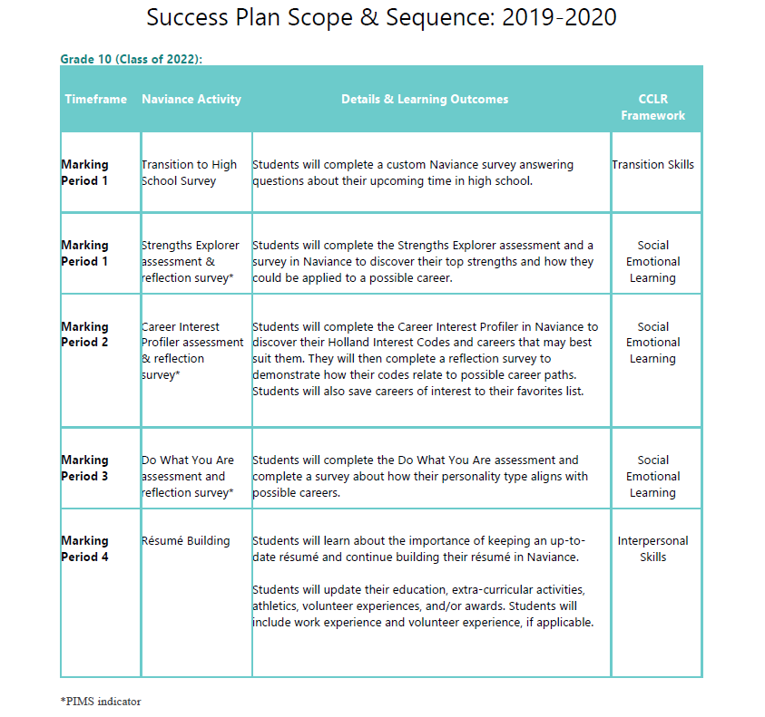

Slide 3
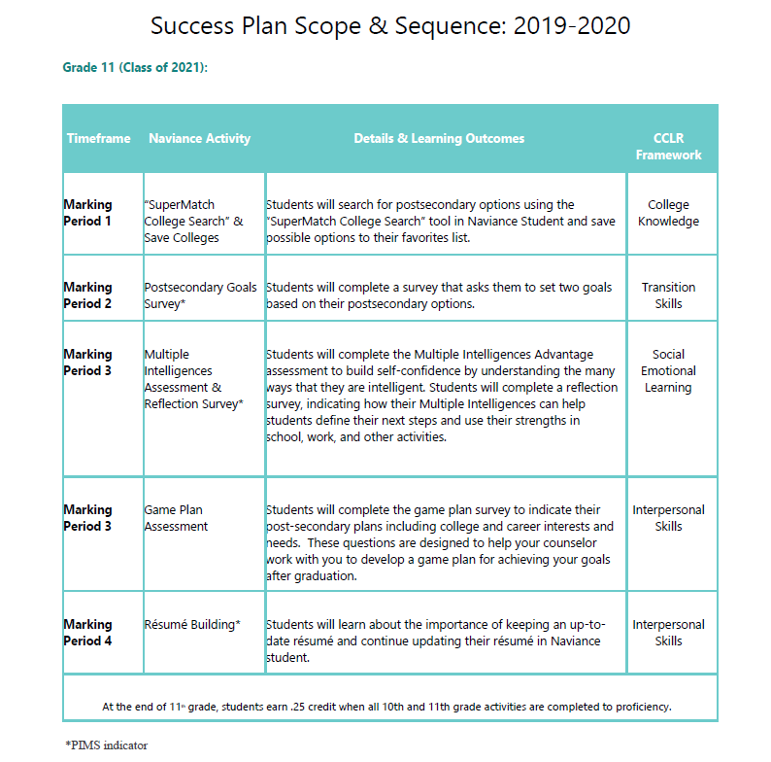

Slide 4
